Slide 1

Connecting Software Reliability Growth Models to Software Defect Tracking
Formal Techniques for Software reliability
MTIS-6203
M.Tech 1st year(Information Security)
Presented By:
Nikhil Soni
Shubham Kumar

Slide 2
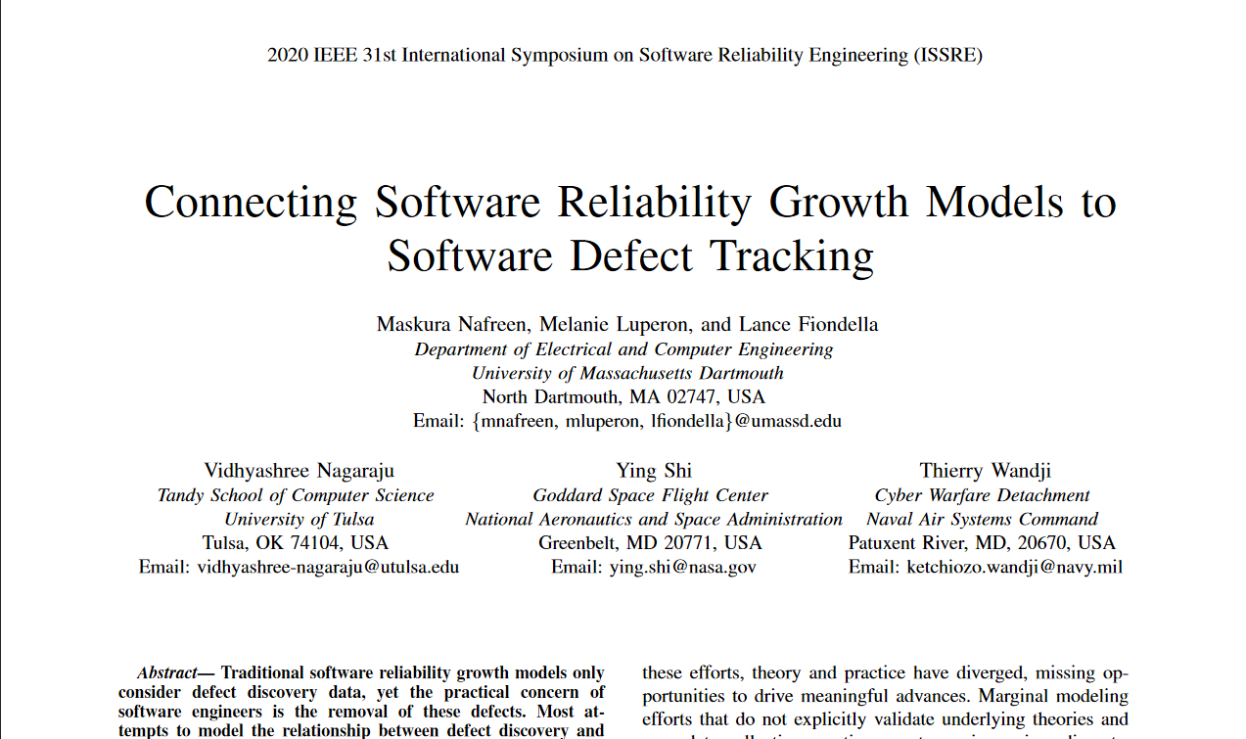
Link: https://ieeexplore.ieee.org/document/9251086

Slide 3
Introduction
Software reliability is deﬁned as the probability of failure-free software operation for a speciﬁed period of time in a speciﬁed environment.
Traditional software reliability growth models only consider defect discovery data
This paper explicitly connects software reliability growth models to software defect tracking.

Slide 4
Software Defect Discovery And Resolution : Concepts
A Defect is a variation or deviation of the software application from end user’s requirements or original business requirements.
In the Defect Discovery phase, the project teams have to discover as many defects as possible, before the end customer can discover it.

Slide 5
Defect Resolution in software testing is a step by step process of fixing the defects.
Schedule fixing: The developer side take charge in this phase. They will create a schedule to fix these defects, depend on the defect priority.
Fix the defect: While the development team is fixing the defects, the Test Manager tracks the process of fixing defect compare to the above schedule.
Report the resolution: Get a report of the resolution from developers when defects are fixed.

Slide 6

INFLECTION S-SHAPED GROWTH MODEL
The first well known idea of software reliability analysis has been proposed by Jelinski and Moranda. Their model allows us to estimate the number of errors that were initially in a tested program and error detection rate which indicates efficiency of testing measures based on the observation of a testing process.
The exponential growth model that has exponential software reliability growth can be characterized by the function:
where m(t) is the cumulative number of errors detected up to time t, N is the number of errors initially in the program, and is the error detection rate of the test.

Slide 7
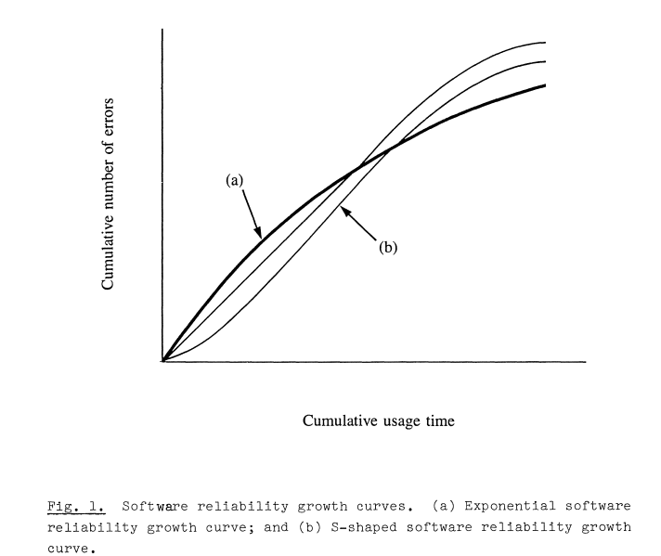

Slide 8


In contrast to the exponential software reliability growth, S shaped software reliability growth is more often observed in real projects. The curve (b) of Figure 1 is typical S-shaped software reliability growth.
The model is characterized by the inflection S-shaped growth mean value function g(t) of NonHomogeneous Poisson Process (NHPP):
where ф is the error detection rate in the sense of the exponential growth model, Ψ is the inflection factor, N is the number of errors initially in a program, and g(t) is the number of detected up to time t. The inflection factor is defined for given r by the following:
Where r is the inflection parameter.

Slide 9
Case Study With Application To NASA Data
Authors applied the Goel-Okumoto, Weibull, Yamada Delayed S-shaped, inﬂection S-shaped, Jelinski-Moranda [24], and Geometric model [25] to input dataset of NASA [20] .
They concluded that the inﬂection S-shaped model is best for defect discovery process.

Slide 10
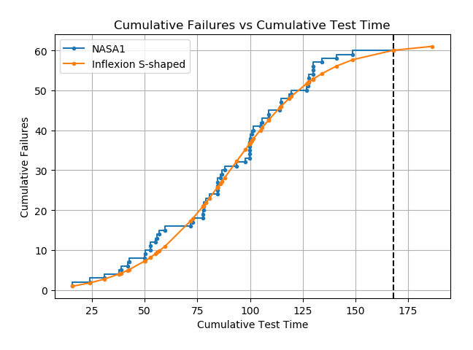
Cumulative Failures:

Slide 11
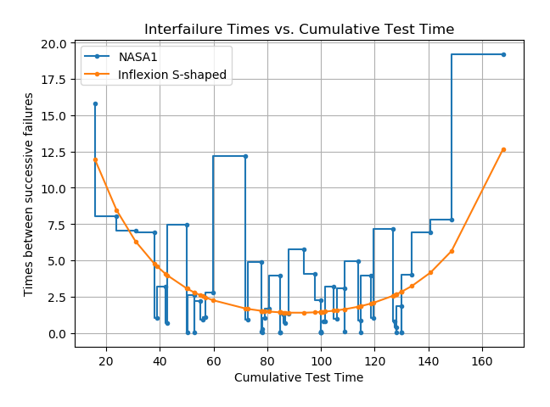
Time between failures

Slide 12
SOFTWARE DEFECT DISCOVERY AND RESOLUTION : MODELS
Integrated defect discovery and resolution processes
Distributional Approach
Markovian Approach
Higher-order Markov Chains

Slide 13
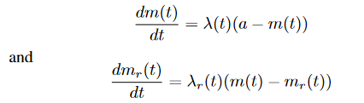
Integrated Defect Discovery and resolution Processes
Where:
mr(t) denotes the mean value function of the number of defects discovered (resolved) by time ‘t’
λr(t) denotes the defect discovery (resolution) rate

Slide 14

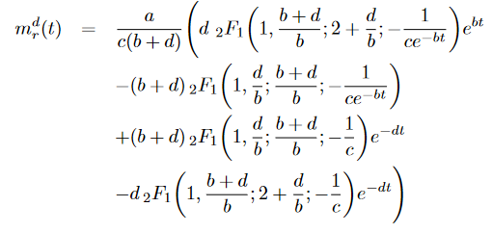
Integrated Defect Discovery and resolution Processes
First Form:
Second Form:

Slide 15
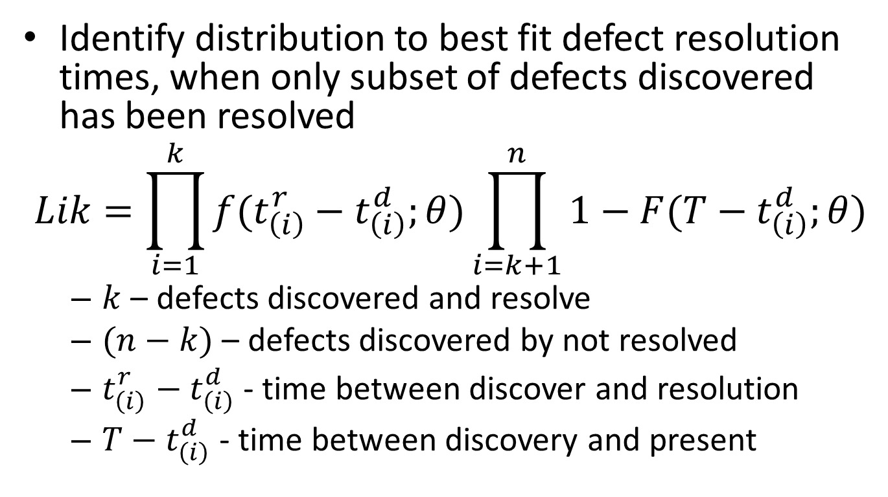
B. Distributional Approach

Slide 16
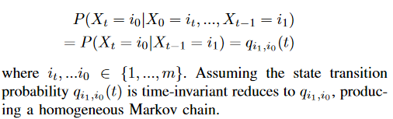

C. Markovian Approach
The first order Markov hypothesis
The average time discovery to resolution

Slide 17
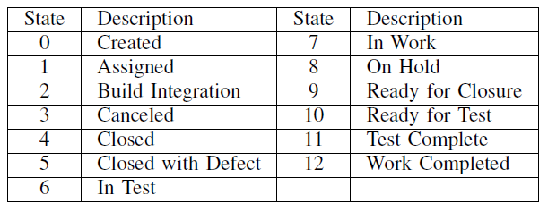
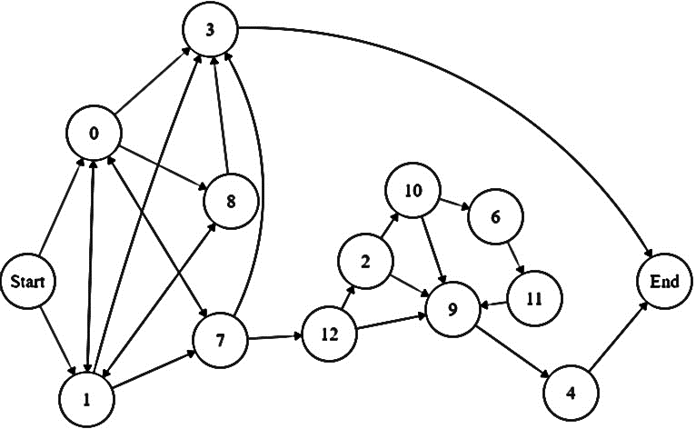
Defect Lifecycle Modeling: Cleaning of Data

Slide 18
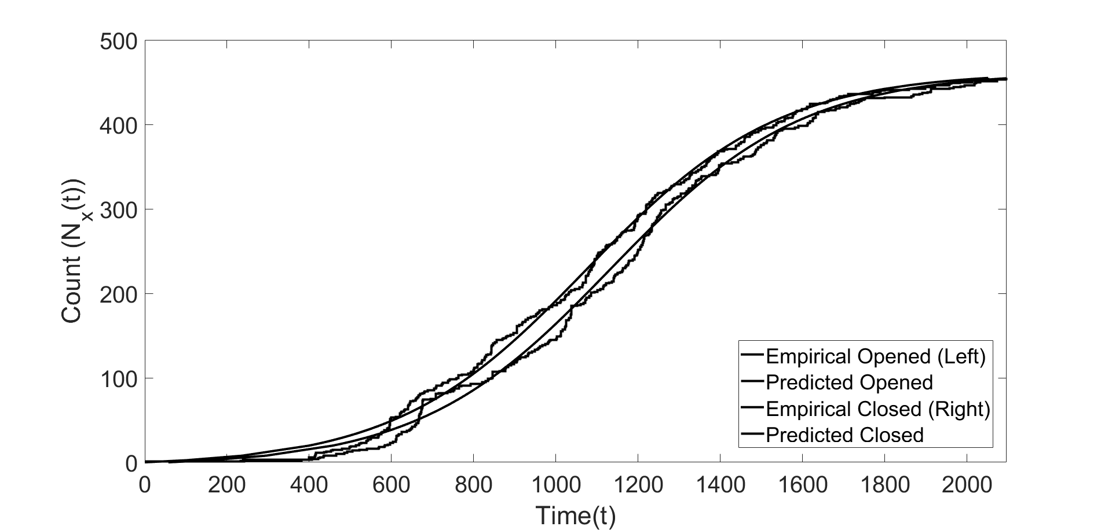
Defect Discovery/Resolution Modeling

Slide 19
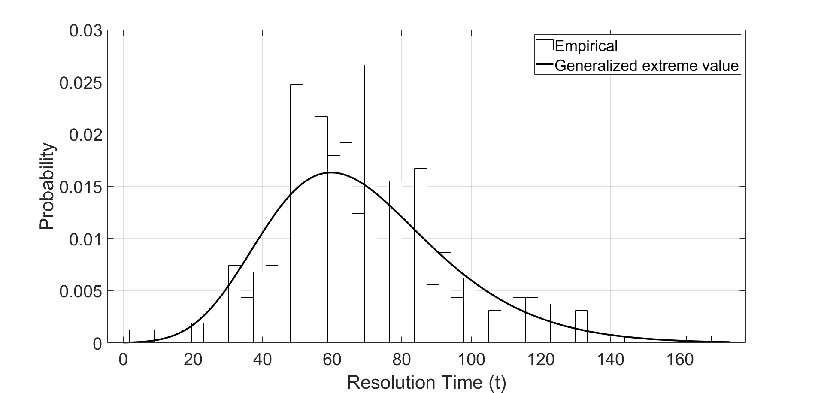
Distribution of time between defect discovery and resolution
Not broken down by severity, number of defects in queue, or other process factors

Slide 20
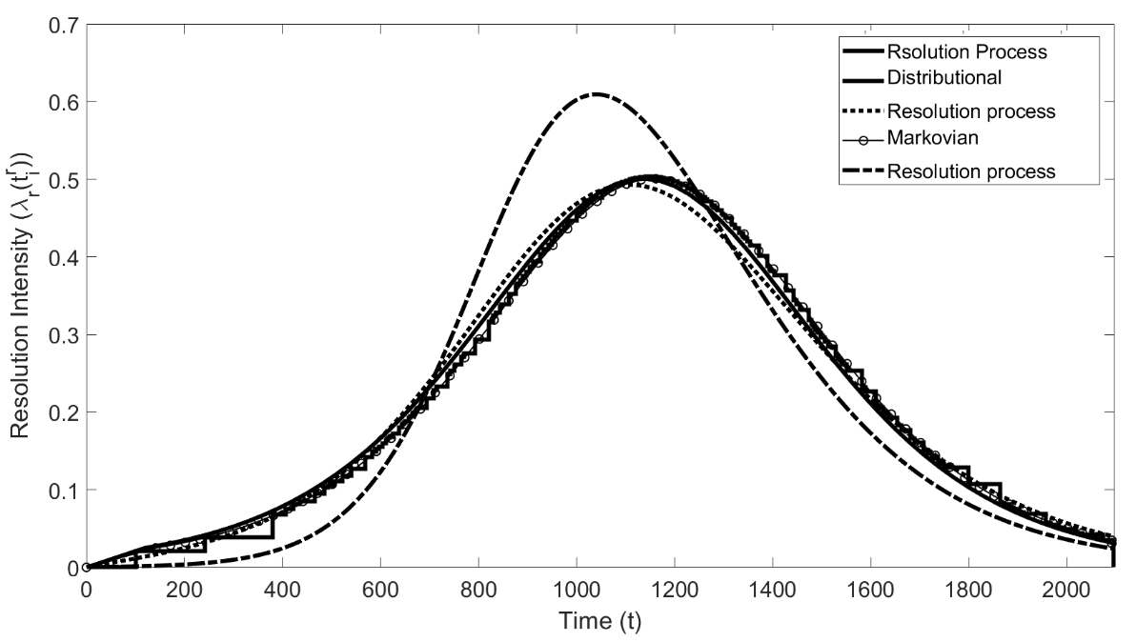
Defect resolution intensity

Slide 21
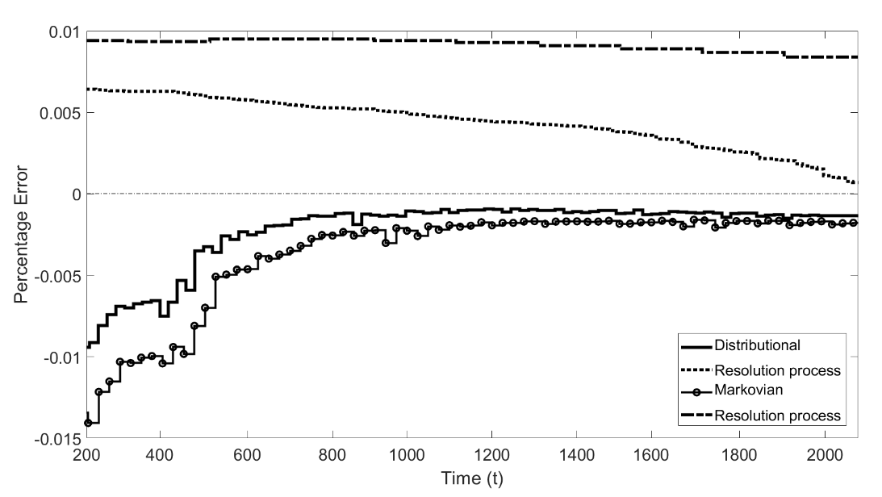
Online defect resolution prediction
Simpler distributional model predicts nearly as well as state model
Hypothesis test suggest state transitions follow first order Markov process

Slide 22
Conclusion
Differential-equation based, distributional, and Markovian approaches were developed by the authors.
NASA defect tracking database was cleaned and a state model constructed.
The predictive accuracy and computational efficiency were assessed in an online manner.
The results suggested that most of the models fit the defect resolution data well, but that the distributional approach achieved the best fit and also demonstrated the lowest runtime, enabling more frequent updates, which would support online tracking when defect detection and resolution are ongoing.

